Slide 1
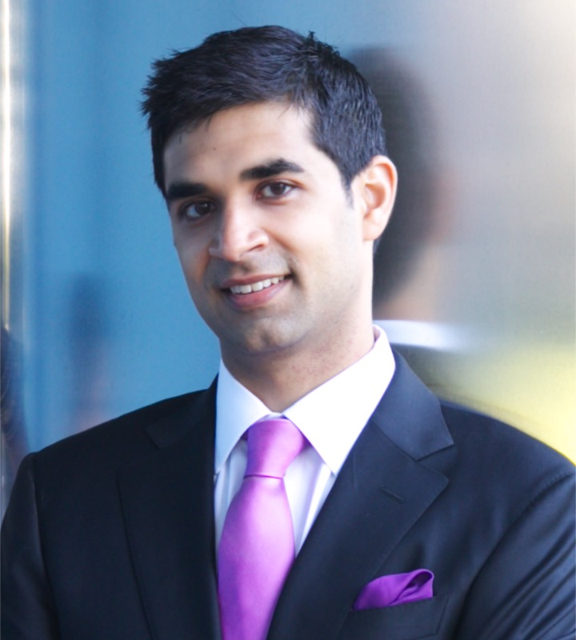
GENETICS, BIOINFORMATICS &
SYSTEMS BIOLOGY COLLOQUIUM
THURSDAY, April 8th 2021
12:00-1:00 PM
Held on Zoom
Click Here for Zoom Link!
Meeting Password: Genetics
Amit V. Khera, MD MSc
Assistant Professor
Harvard Medical School
guest speaker
Human genetics – a tool to uncover new biology and enable enhanced clinical care
Key goals of precision medicine include (i) disaggregation of common diseases into discrete molecular subtypes and (i) identification of high-risk individuals to enable preventive therapies prior to disease onset. One important approach is to stratify individuals based on inherited DNA variation. Rare DNA variants that perturb a specific pathway can provide generalizable insights into disease biology and enable targeted therapies. Taking coronary artery disease as an example, our recent analyses identified four molecular subtypes that account for ~2% of affected individuals, with risk driven by high cholesterol, impaired clearance of dietary fat, abnormal vascular tone, and abnormal bone turnover. For the remaining 98% of individuals, we developed a new type of genetic predictor (‘polygenic score’) that integrates information from many variants and pathways, identifying – in some cases – individuals with risk equivalent to rare monogenic mutations. These individuals are ‘flying under the radar’ within clinical practice, but derive increased benefit from lifestyle or cholesterol-lowering interventions. Beyond risk stratification across a range of important diseases, polygenic scores may prove useful in: (i) explaining why some individuals who carry rare risk mutations (e.g. BRCA1 for breast cancer) remain healthy, (ii) enriching clinical trials for a higher event rate, and (iii) nominating new biomarkers for conditions such as Alzheimer disease based on molecular profiling of asymptomatic individuals within the tails of the distribution. Moving forward, realization of the full benefit of human genetics will require intersection with enhanced phenotyping — such as machine-learning on raw abdominal MRI images — and new clinical infrastructure— such as the MGH Preventive Genomics Clinic.
Faculty Host: Adam Engler
Presented by:
For ongoing updates on upcoming lectures:
Visit genomic.weebly.com
Organization Committee: J. Gleeson, F. Furnari, A. Majithia, T. Gaasterland
GBSBC Seminar Coordinators: R. White, S. Orosco
SPECIAL THANKS TO OUR SPONSORS:

