Slide 1
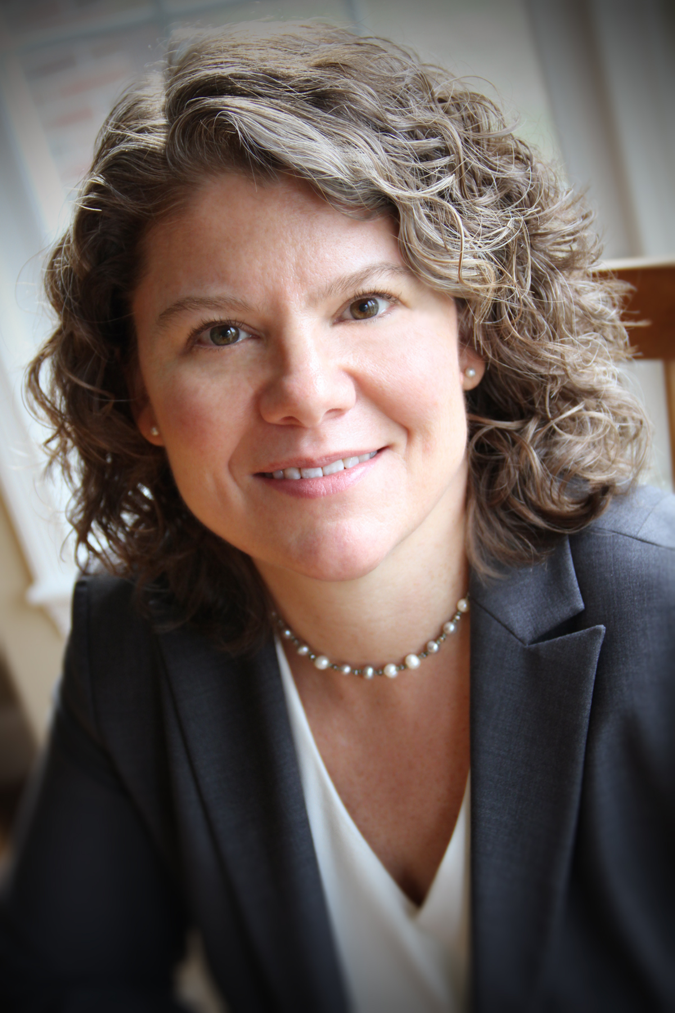
GENETICS, BIOINFORMATICS &
SYSTEMS BIOLOGY COLLOQUIUM
THURSDAY, January 21st
12:00-1:00 PM
Held on Zoom
Click Here for Zoom Link!
Meeting Password: IGM
Replace with speaker headshot
Heidi Rehm, PhD
Professor of Pathology, Harvard Medical School
Chief Genomics Officer, MGH
Talk Title: Advancing Medicine Through Collaboration on a Global Scale
Supporting genomics in the practice of medicine requires extensive infrastructure, including standards, knowledgebases and global data sharing, as well as a rich interface between research and clinical care as new gene-disease relationships continue to be discovered at a rapid pace. This talk will present community efforts to support clinical genomics including the knowledge curation performed within the Clinical Genome Resource, novel gene discovery efforts of the Broad Center for Mendelian Genomics and touch on related topics such as the Matchmaker Exchange, the Gene Curation Coalition, and the All of Us Research Program.
Faculty Host:
Student Host:
Presented by:
For ongoing updates on upcoming lectures:
Visit genomic.weebly.com
Organization Committee: J. Gleeson, F. Furnari, A. Majithia, T. Gaasterland
GBSBC Seminar Coordinators: S. Hadimulia, S. Orosco
SPECIAL THANKS TO OUR SPONSORS:

