Slide 1
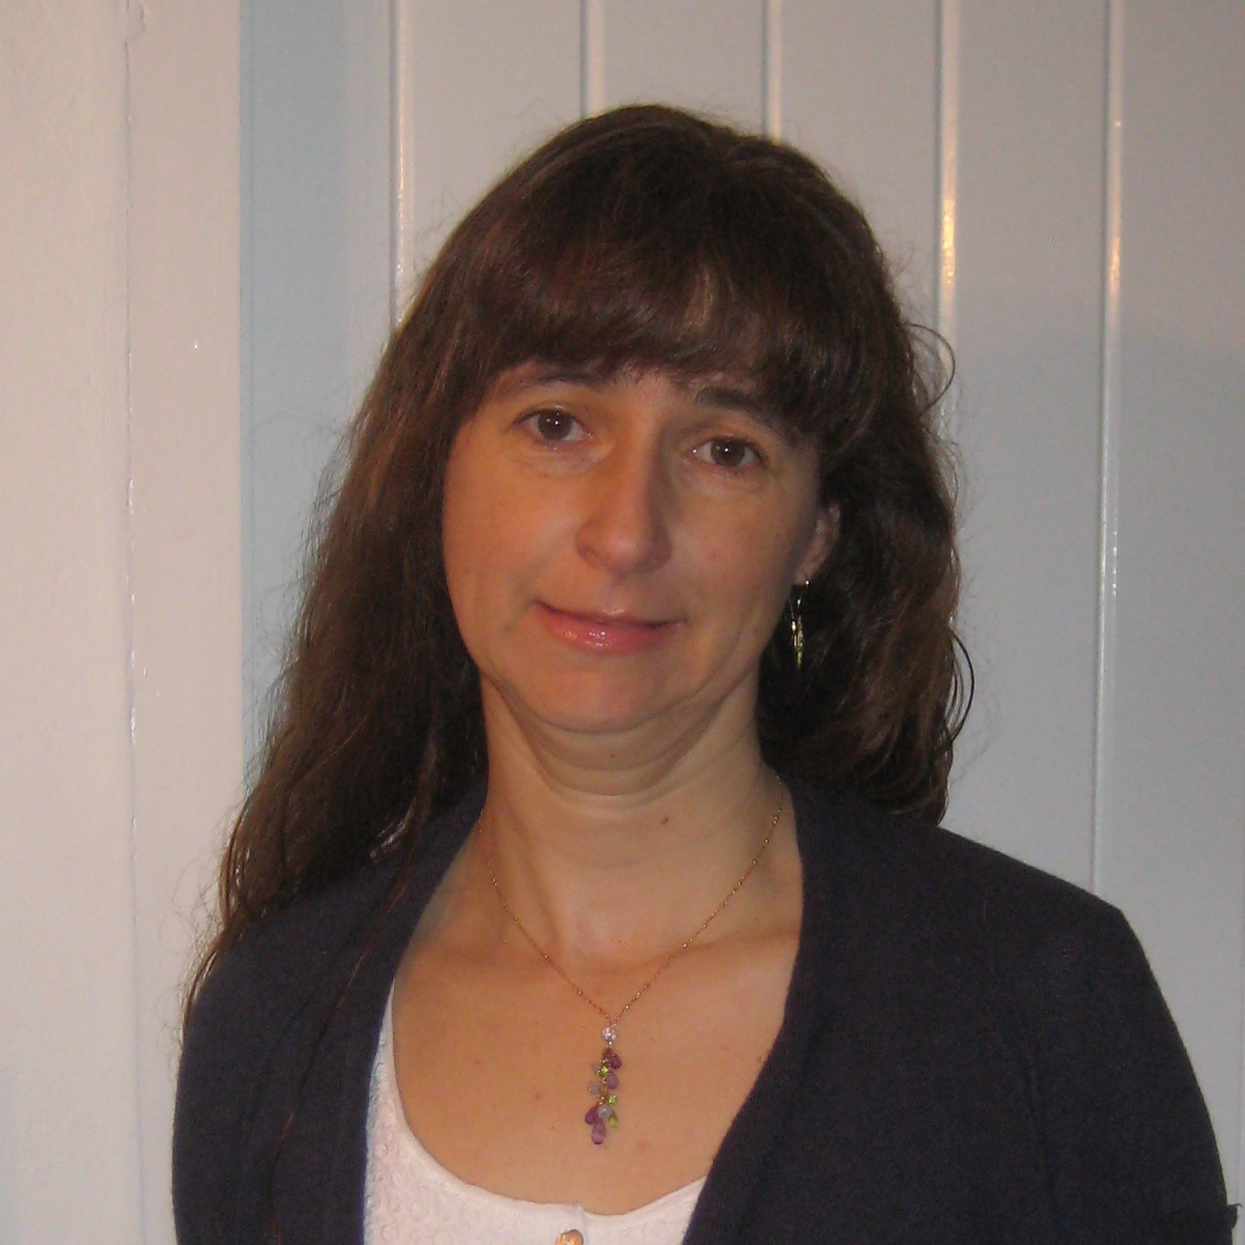
GENETICS, BIOINFORMATICS &
SYSTEMS BIOLOGY COLLOQUIUM
THURSDAY, May 13th
12:00-1:00 PM
Held on Zoom
Click Here for Zoom Link!
Meeting Password: Genomics
Inês Barroso, PhD
Professor of Diabetes
EXCEED (Exeter Centre of Excellence for Diabetes Research)
University of Exeter Medical School
The Trans-Ancestral Genomic Architecture of Glycaemic Traits
Glycaemic traits are used to diagnose and monitor diabetes, are associated with cardiovascular complications, and can inform pathophysiology in type 2 diabetes. Within MAGIC (Meta-Analysis of Glucose and Insulin-related traits Consortium) we have analysed large- scale genetic data across five ancestries (71% European, 13% East Asian, 7% Hispanic, 6% African-American and 3% South Asian) relating to four glycaemic traits (fasting glucose, fasting insulin, 2h glucose and HbA1c). Trans-ancestry and single-ancestry meta-analyses identified 242 loci (99 novel; P<5x10-8), 80% with no significant evidence of between-ancestry heterogeneity. Analyses restricted to European ancestry individuals with equivalent sample size would have led to 24 fewer new loci. Compared to single-ancestry, equivalent sized trans-ancestry fine-mapping reduced the number of estimated variants in 99% credible sets by a median of 37.5%. Combining genetic results with additional genomic datasets (genomic feature annotation and expression datasets) has provided insights into genomic and expression signatures of each glycaemic trait. In my talk I will present results relating to the similarities and differences observed between glycaemic traits, insights gained from trans-ethnic analysis, and pathway and gene-set analysis. These data provide additional biological insights relating to glycaemic traits, and can provide mechanistic insights into type 2 diabetes pathophysiology.
Faculty Host: Maike Sander
Presented by:
For ongoing updates on upcoming lectures:
Visit genomic.weebly.com
Organization Committee: J. Gleeson, F. Furnari, A. Majithia, T. Gaasterland
GBSBC Seminar Coordinator: R. White
SPECIAL THANKS TO OUR SPONSORS:

